Slide 1
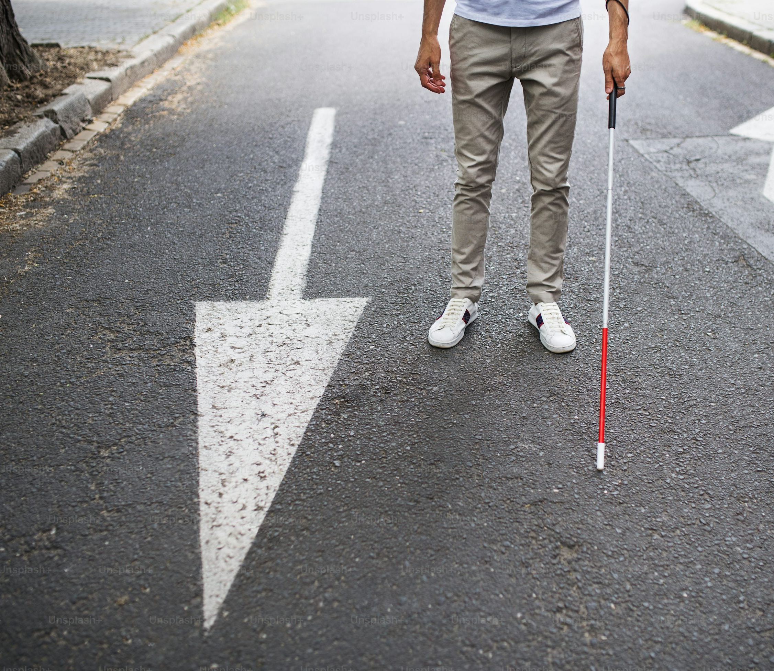

Advanced Human Machine Interaction Project: Multimodal Smart Cane
Presented by
Nathan Lambrechts
Edwyn Eben
Louca Mathieu
Simon Dourte
Florian Stormacq

Slide 2
Summary :
Problem
The target audience
Our solution and motivation
How our solution addresses our challenge
Limitations and problems encountered
Demo

Slide 3
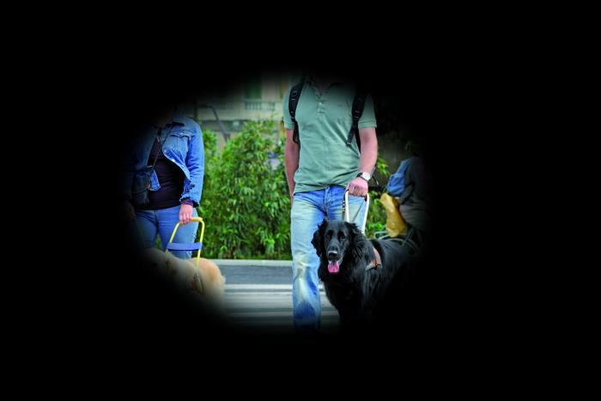

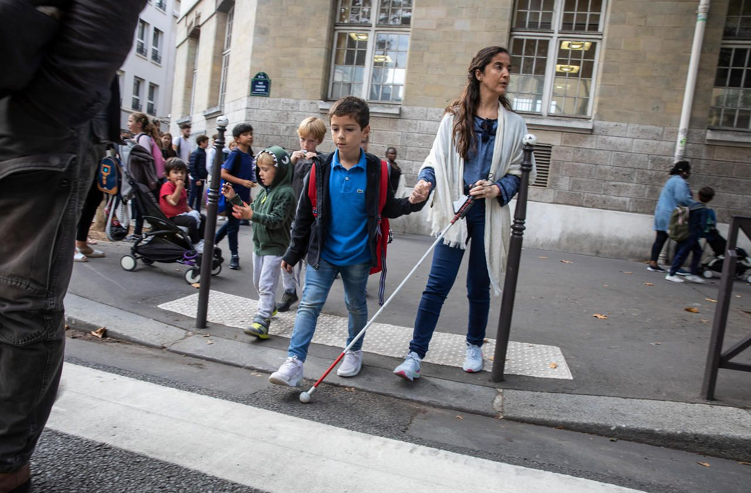
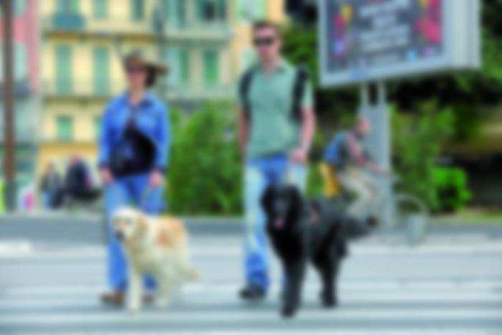
Problem
→People with visual impairments represent a significant proportion of the global population. It is estimated that at least 2.2 billion people have some form of vision impairment.
→ It is therefore essential to develop solutions that meet their needs and improve their independence

Slide 4

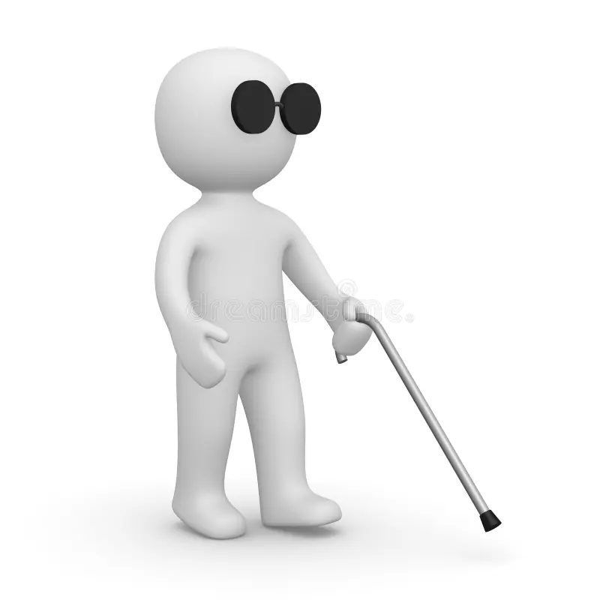

The target audience
Blind people Visually impaired people
Particularly those who are on the move: in urban environments, in situations where obstacles or hazards may arise, and who require non-visual assistance.

Slide 5

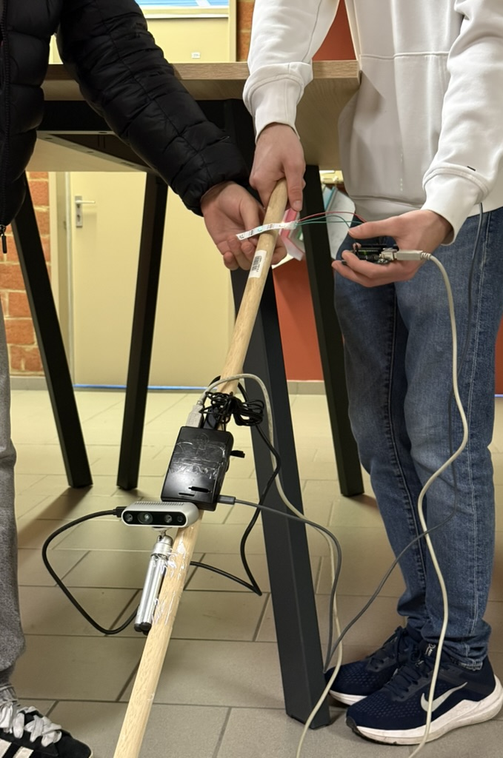
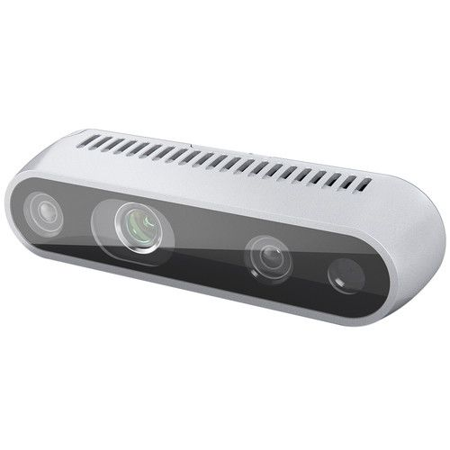
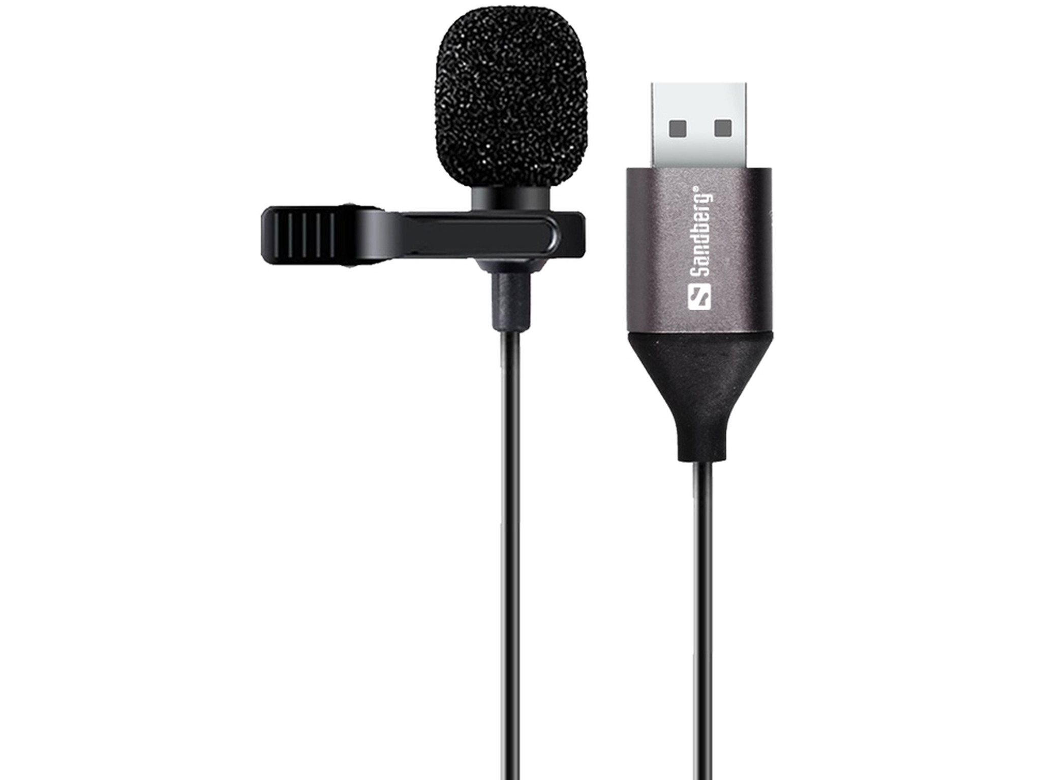
Our solution and motivation
The goal of the project is to develop an adaptive smart cane designed to improve spatial awareness and safety for visually impaired people.
The cane is based on two main sensors: an Intel RealSense D435 depth camera and a USB microphone

Slide 6
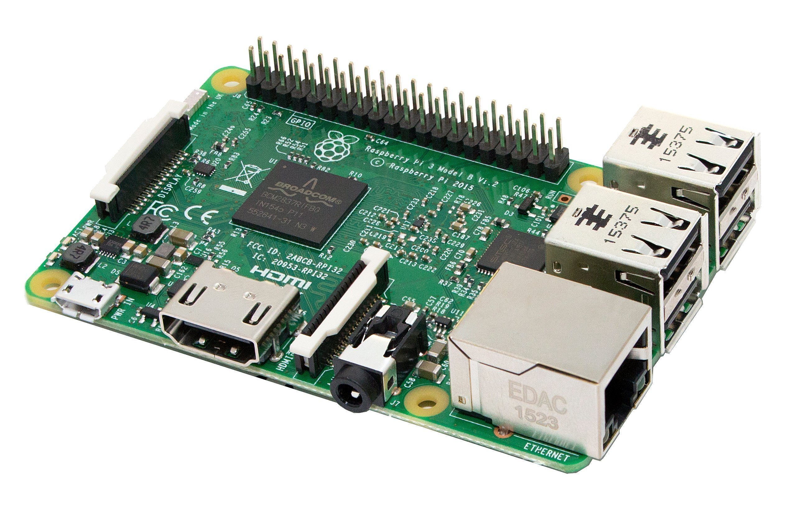
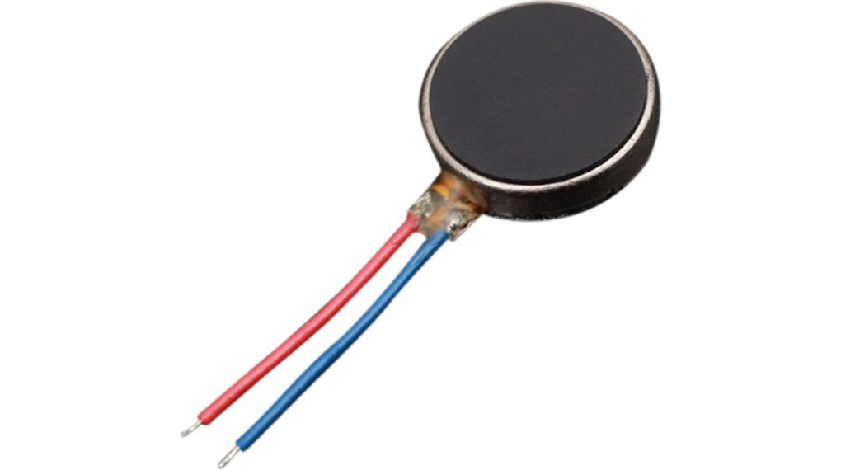

Our solution and motivation
The data from these sensors is processed in real time by a Raspberry Pi 3.
User feedback is provided by three vibrating motors and the intensity of the vibrations indicate the proximity of the danger and guide the user as they move
Arduino will be used as an interface between the central processing (Raspberry) and the physical actuators (vibration motors)

Slide 7

How our solution addresses our challenge
The vibration intensity reflect the proximity of the danger allowing the user to interpret the environment with the haptic output.
Improve their perception of their surroundings and increase their safety in the face of potential obstacles and dangers.

Slide 8

Limitations and problems encountered
Performance issue:
The initial Raspberry Pi 1 was not powerful enough to handle the processing requirements.
→ Configuration Issue:
Setting up the Raspberry Pi proved to be more challenging than anticipated.
→ Complex installation of the RealSense camera :
Intel RealSense Python library required to clone the library from GitHub and build it from source.

Slide 9
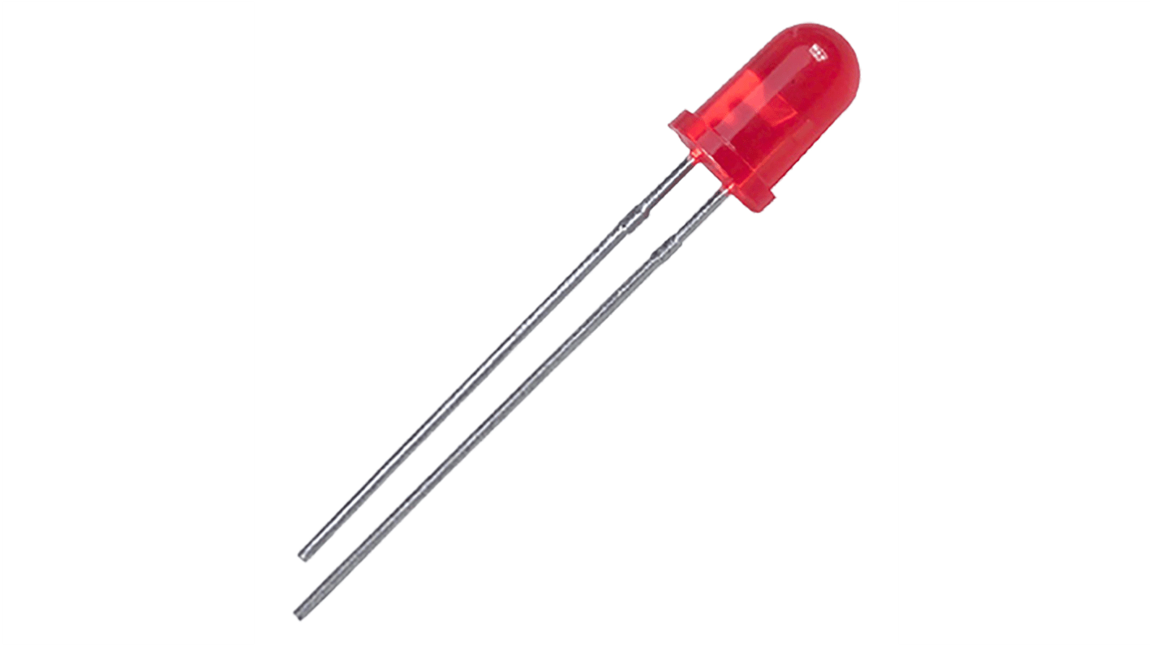
Limitations and problems encountered
→ Difficult sensor synchronization :
The synchronization of the data from both sensors has been challenging.
→ Hardware problems with vibrating motors :
The vibration motors have temporarily been replaced with LEDs for testing purposes due to a voltage issue. Moreover, the brightness of the LEDs was not entirely reliable.
No environment tests were conducted:
Due to limited time, even though the device is still a prototype and tuning the code parameters could have significantly improved the user experience.

Slide 10
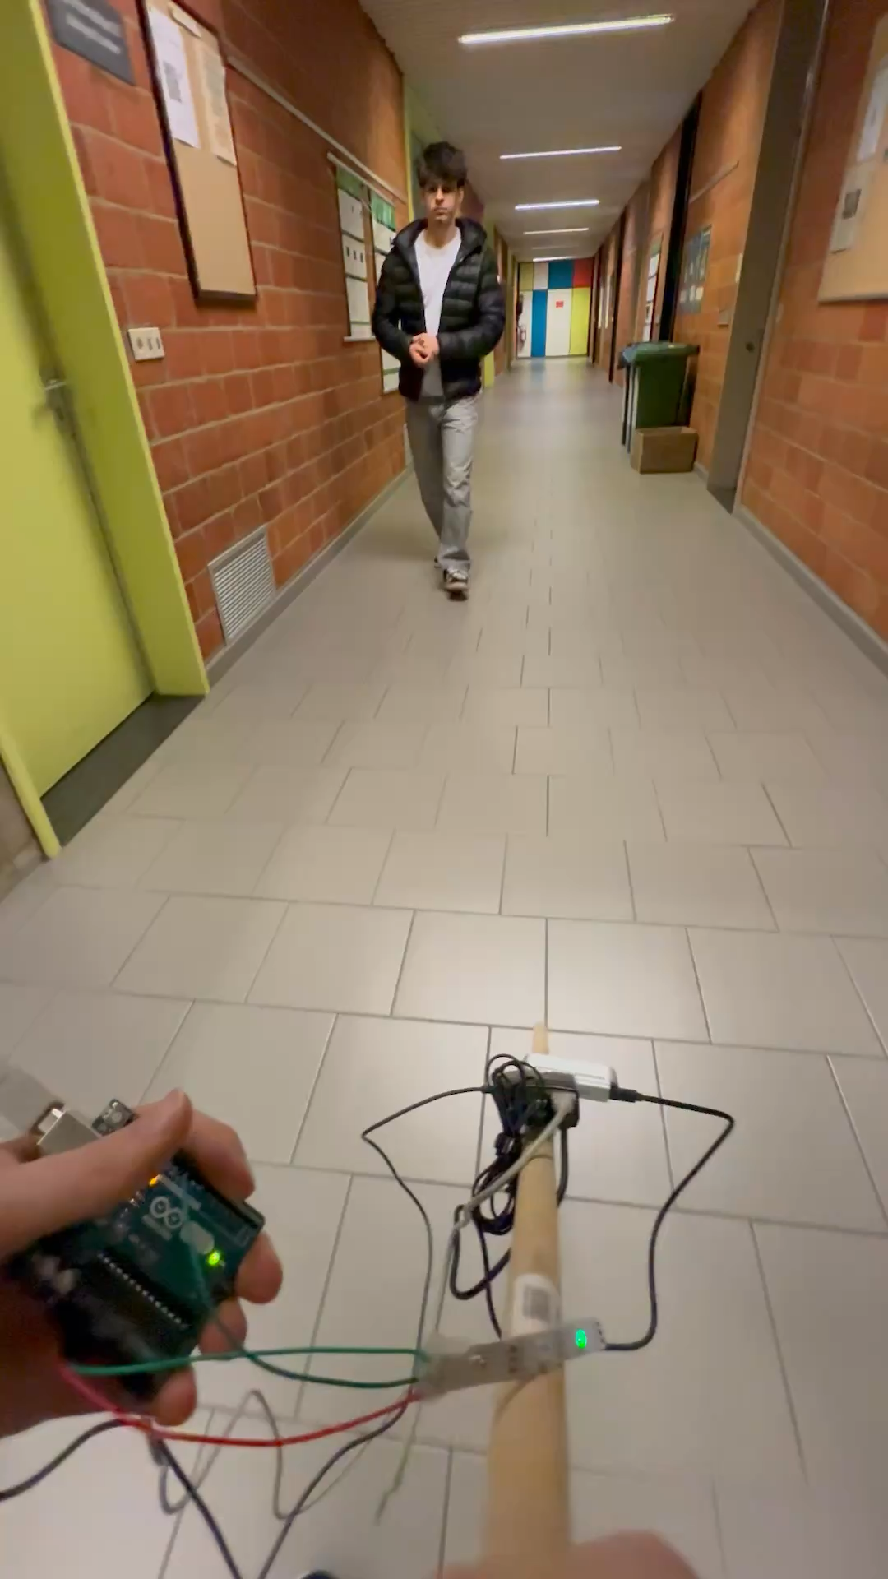

Demo

Slide 11


The end and FAQ
Thank you for listening!

